Slide 1

CMR COLLEGE OF ENGINEERING & TECHNOLOGY
Kandlakoya, Medchal, Hyderabad - 501401
Department of Computer Science and Engineering
DERMATOLOGICAL MALIGNANCY DETECTION USING CNN
Name of the students
20H51A05H7- M.Deepak reddy
20H51A05L7- S.Jashwitha
20H51A05P6- M.V Devendranathreddy
Under esteemed guidance of
Ms. Komal Parashar (Assistant Professor )

Slide 2
Outline
Abstract
Introduction
Literature survey
Existing system
- Problems in existing system
Research Objective of Presentation
Problem Definition
Research work
- Proposed system architecture
- Methods
- Comparison of Proposed system with an existing system
Performance Measure
Results
Conclusion
Future Work
References
Notes:
2

Slide 3
Abstract
Notes:
3

Slide 4
ABSTRACT
Skin cancer is a prevalent and potentially life-threatening disease that continues to pose a significant public health concern. Starting stage detection plays a crucial part in enhancing treatment efficiency. Furthermore, the advancement of deep learning has enabled the creation of automated frameworks for detecting malignant cancer.
This proposed system utilizes a diverse dataset of dermoscopic images, a deep learning model is trained to classify and recognizes them as benign(notcancerous) and malignant(cancerous)lesions.
Utilizing CNN, pertinent features are automatically extracted from skin cancer images, facilitating precise classification.Comparative assessments against conventional techniques underscore the superior efficiency and effectiveness of the devised model in identifying potential skin cancer instances.
Experimental results demonstrate the model's high accuracy, sensitivity, and specificity, showcasing its potential as an effective tool for assisting dermatologists.

Slide 5
INTRODUCTION
Notes:
5

Slide 6
Introduction
The main aim of skin cancer detection is to detect cancer easily and at earlier stage than traditional system.
Early detection of skin cancer significantly increases the chances of successful treatment and reduces mortality rates. Traditional methods of diagnosis involve visual inspection by dermatologists, which can be time-consuming and subject to human error. Deep learning offers an opportunity to automate and enhance the accuracy of this process.
Deep learning models, particularly convolutional neural networks (CNNs), have shown remarkable success in image analysis tasks, including medical image analysis.
Notes:
6

Slide 7
Literature Survey
Notes:
7

Slide 8
Existing system
Skin cancer classification using Resnet:
Skin cancer detection using ResNet involves employing a learning model, specifically ResNet (Residual Neural Network), to analyze and classify skin lesions as either benign or malignant network Evaluate the data model on the test the dataset set to assess its generalization performance. Continuous monitoring and updates may be necessary to adapt to new data and enhance the model's performance over time.
Drawbacks:
Limited Dataset: ResNet, like many deep learning models, requires a large and diverse dataset for training.
Dependency on Image Quality: ResNet's performance may be affected by the quality of the input images. Poorly captured or low-resolution images may lead to inaccurate predictions.
Interpretability: Deep learning models like ResNet are often considered black boxes, making it challenging to interpret the features they learn to make predictions.
Notes:
8

Slide 9
Skin cancer classification using Vggnet:
Obtain a dataset of dermatological cancer images. A ubicutious fine-tuning it on a dataset of skin cancer images resize images to the input size required by the VGGNet model (typically 224x224 pixels). Load the pre-trained VGGNet model. You can use a pre-trained VGG16 or VGG19 model from a learning library like Keras or PyTorch. Train the modified VGGNet on your skin cancer dataset. Use the training for instruction and the validation set to monitor the model's performance and avoid overfitting. Fine-tune the model by adjusting turning parameters like lsteprate,grouping magnitude, and the number of epochs., Utilize metrics such as exactitude, exactness, retrieval rate to evaluate the model's effectiveness in skin cancer classification.
Drawbacks:
Depth and Complexity: VGGNet has a deeper architecture compared to other models which can lead to increased computational requirements during training and inference.
Large Number of Parameters: VGGNet has a large number of parameters, particularly due to its numerous convolutional layers.

Slide 10
Research Objective
Notes:
10

Slide 11
Research objective
The primary objective of this study is to develop a deep neural network-based model for skin cancer detection, aimed at overcoming the challenges associated with traditional diagnostic methods.
This model aims to automate and optimize the classification of skin cancer, improving accuracy and accessibility for early diagnosis.
Aim to achieve high accuracy and sensitivity rates in detecting skin cancer lesions, with the goal of minimizing false negatives

Slide 12
Problem Definition
Notes:
12

Slide 13
Problem Definition
Skin cancer is a significant global health concern, with its early detection being crucial for effective treatment. Traditional diagnostic methods often rely on visual inspection by dermatologists, which can be time-consuming and subjective.
Skin cancer detection using deep learning involves developing a model capable of accurately classifying skin lesions as malignant (cancerous) or benign (non-cancerous) based on images of the skin. The goal is to provide a reliable and automated tool for early detection of skin cancer, which can assist healthcare professionals in making more accurate diagnoses.
Therefore, the development of accurate and reliable automated systems for skin cancer detection has become imperative. The aim of this research is to leverage the power of deep learning techniques to create efficient model capable of classifying skin lesions malignant categories based on dermoscopic images.

Slide 14
Research Work
Notes:
14

Slide 15
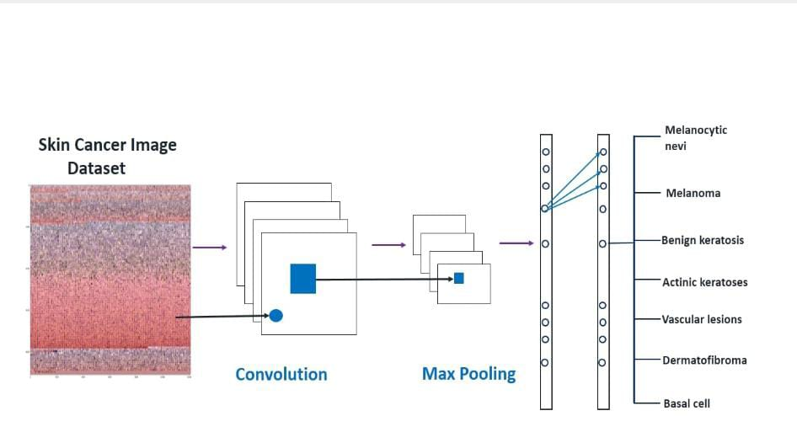
Proposed system architecture

Slide 16
Proposed Methods
CNN Algorithm:
CNNs, or convolutional neural networks, are a subset of a CNN's convolutional phase is its basic construction phase. With the aim of extract Extracting distinct characteristics from the input data at a local level, it applies a group of filters, also known as kernels. These filters create a responce map by swiping upon the randicoms and multiplying each element by the local region.
Convolutional Layer: The input volume's spatial dimensions are down sampled through the utilization for pooling layers. By taking the maximum value from a collection of values in a region, a typical approach called "max pooling" reduces the spatial size while preserving the most crucial information. Pooling Enhances the network further resilient and reduces processing.
2. Pooling Layer: The input volume's spatial dimensions are down sampled through the application of pooling layers. By taking the maximum value from a group of valuesin a region, a typical approach called "max pooling" reduces the spatial size while preserving the most crucial information. Pooling Augments the network's capabilities further resilient and reduces processing.

Slide 17
3. Activation Function: A mathematical operation that is applied to a neural network neuron's (or node's) output is known as an activation function. It provides the network non-linearities, which enable a. The An activation function uses its input, or group of inputs, to determine a neuron's output.
4. Training: With the intent of a (CNN) to generate accurate predictions on new, unseen data, the model's parameters (weights and biases) are optimized using a labeled dataset.
5. Output Layer: Reliant on the task at hand, the output layer's activation function (softmax is frequently utilized for multi-class.

Slide 18
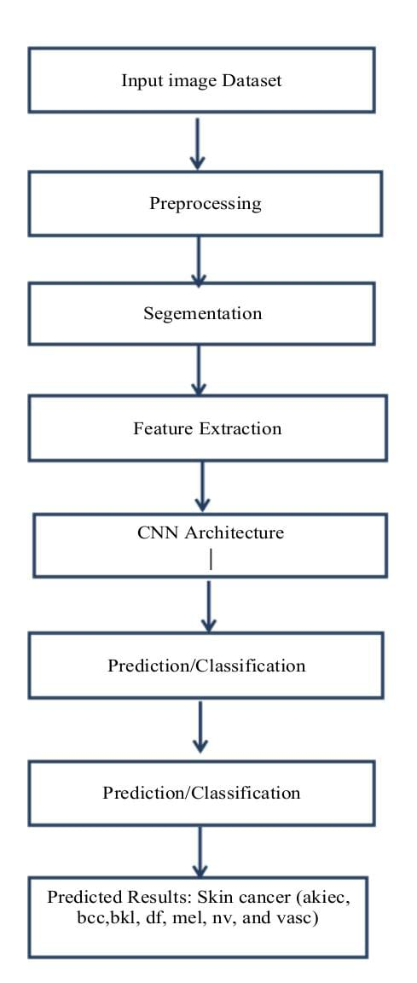
User interface architecture

Slide 19
Performance Measure:
Performance metrics for skin cancer detection using Convolutional Neural Networks (CNNs) typically include:
1. Accuracy: The proportion of correctly classified images out of the total number of images. Accuracy=Number of correctly classified imagesTotal number of imagesAccuracy=To tal number of imagesNumber of correctly classified images
2. Precision: The ratio of true positive predictions to the total number of positive predictions. It measures the classifier's ability to not label a negative sample as positive.
METHOD | DATA SET | PERFORMANCE
vggnet | ISIC | 73%
Transfer learning | SCD | 80%
Cnn | Ham10000 | 94%

Slide 20
Result Analysis
In skin cancer detection using CNNs, The model's efficacy is typically evaluated using various metrics to assess its accuracy and effectiveness. Below are metrics and results that are often considered Precision among all the samples predicted as positive. It is computed as the proportion of correctly identified positive predictions relative to the aggregate of true positives and false positives.

Slide 21
Conclusion
In conclusion,the application of CNN for dermatological malignancy detection represents a significant advancement in the field of skin and medical imaging. The model which we are developing will ensure to detect the skin cancer according to the dataset.With the help of this model we can detect the skin cancer in the early stage. Ultimately, the deployment of deep learning-based systems in clinical practice has the potential to revolutionize early diagnosis rates and significantly improve patient outcomes in the battle against skin cancer.

Slide 22
Future work
The future enhancement of skin cancer detection using deep learning involves several potential advancements and innovations, which may include but are not limited to:
1. Improved Data Collection and Quality: Expanding and diversifying the datasets used for training deep learning models can improve their accuracy and generalizability. This includes collecting high-quality images of various skin types, cancer stages, and underrepresented groups.
2. Integration of Multimodal Data: Combining images with other types of data such as patient history, genetic information, and environmental factors could enhance the predictive
3. Augmented Reality (AR) and Virtual Reality (VR): Implementing AR and VR technologies for educational and diagnostic purposes can provide interactive and immersive ways to detect and understand skin cancer, aiding both patients and healthcare providers.
4..Personalized Treatment Recommendations: Beyond detection, deep learning models could be enhanced to recommend personalized treatment plans based on the specific characteristics of the cancer and the patient, optimizing outcomes.

Slide 23
References
S. Prasher, L. Nelson and S. Gomathi, "Resnet 50 Based Classification Model for Skin Cancer Detection Using Dermatoscopic Images," 2023 3rd Asian Conference on Innovation in Technology (ASIANCON), Ravet IN, India, 2023,pp. 1-5, doi: 10.1109/ASIANCON58793.2023.10270158.
Nourabuared, “Skin Cancer Based on VGG19 and Transfer Learning”, In 3rd International Conference on Signal Processing and Information Security IEEE Conference, pp 1-4, DOI
N. C. Lynn and Z. M. Kyu, , Taipei, Taiwan, 2017, pp. 117- 122, DOI: 10.1109/PDCAT.2017.00028.
Harikrishna, “Skin Cancer Classification using Transfer Learning IEEE International Conference on Advent Trends in Multidisciplinary Research and Innovation (ICATMRI-2020)
N. C. LYNN AND Z. M. KYU, "SEGMENTATION AND 1 CLASSIFICATION OF SKIN CANCER MELANOMA FROM SKIN LESION IMAGES," 2017 18TH INTERNATIONAL CONFERENCE ON PARALLEL AND DISTRIBUTED COMPUTING, APPLICATIONS AND TECHNOLOGIES, TAIPEI, TAIWAN, 2017, PP. 117-122, DOI: 10.1109/PDCAT.2017.00028.

Slide 24
Thank You!

